Slide 1

Web/iOS Development
Shyne
2014.10.08

Slide 2

Today
Questions or suggestions?
Software architecture
  Front end / Back end
  LAMP/ Full-stack
  App
Typical App/Web architecture
Case study
  Parse.com

Slide 3
[Software architecture]

Slide 4
Software architecture
  Software architecture is the high level structure of a software system, the discipline of creating such a high level structure, and the documentation of this structure.

Slide 5
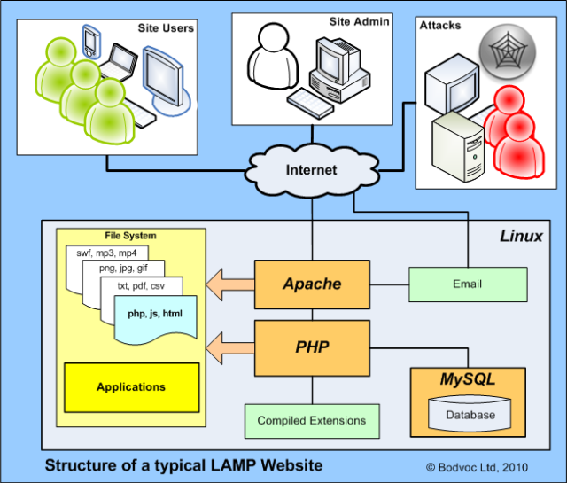
Software architecture diagram

Slide 6
Front ends / back ends
“Front end" and "back end" are distinctions which refer to the separation of concerns between a presentation layer and a data access layer respectively
Client side vs. server side
The front end is an interface between the user and the back end. The front and back ends may be distributed amongst one or more systems.
The front is an abstraction, simplifying the underlying component by providing a user-friendly interface

Slide 7
Front end development
Front end development is the development of those elements of a website that the customers sees and interacts with directly.
It is a combination of programming skills (knowing which program to choose) and aesthetics (understanding element arrangements on the screen, the color and font choices).
The challenges associated with front end developers is that the tools and techniques used to create the front end of a website change constantly and so the developer needs to constantly be aware of how the field is developing

Slide 8
Front end development tools
HTML
  HyperText Markup language (HTML) is the backbone of any website development process is the HTML code that provides an overall framework of how the site will look. The latest version of HTML is called HTML5 which has new and efficient way of handling elements such as video and audio files.
CSS
  Cascading Style Sheet (CSS) controls the presentation aspect of the site and allows your site to have its own unique look. It does this by maintaining style sheets which are one on top of the other using style rules and get triggered based on other inputs such device and screen size and resolution
CMS – (WordPress, Joomla & Drupal)
  Content Management System (CMS) is a tool to add, publish, edit and manage content for a website all from a central location.
Javascript
  Javascript programming language that is used to make asynchronous applications executed on the fly on the browser as unobtrusive rich functionality

Slide 9
Front end developer tools
If you can only choose one….
Chrome dev tools
https://developer.chrome.com/devtools
http://discover-devtools.codeschool.com/

Slide 10
Back end development
The back-end development is a part of the application that is never visible to the user. It is built with use of server-side language and
Operation of back-end code is a bit more complex. The developer builds an application (using server-side code like PHP, Ruby, Python, .Net etc.) which connects with a database (using MySQL, SQL, Access etc.) to look up, save or change data and return it back to the user in form of front-end code
Tools? iHower!

Slide 11
LAMP
Idea: an operating system, a server, a database and middleware
LAMP stack
  Linux
  Apache
  MySQL
  Perl (PHP, Python?)
And now..
  Linux
  Nginx
  noSQL
    MongoDB
    Cassandra

Slide 12
Full-stack
A "full-stack programmer" is a generalist, someone who can create a non-trivial application by themselves.
People who develop broad skills also tend to develop a good mental model of how different layers of a system behave.
This turns out to be especially valuable for performance & optimization work.
No one can know everything about everything, but you should be able to visualize what happens up and down the stack as an application does its thing.

Slide 13
Mobile application
A mobile app is a computer program designed to run on smartphones, tablet computers and other mobile devices.
The term "app" is a shortening of the term "application software”
iOS vs. Android vs. mobile web. Which one to choose?

Slide 14
Mobile application development
Developing apps for mobile devices requires considering the constraints and features of these devices. Mobile devices run on battery and have less powerful processors than personal computers and also have more features such as location detection and cameras. Developers also have to consider a wide array of screen sizes, hardware specifications and configurations because of intense competition in mobile software and changes within each of the platforms.
Mobile application development requires use of specialized integrated development environments. Mobile apps are first tested within the development environment using emulators and later subjected to field testing. Emulators provide an inexpensive way to test applications on mobile phones to which developers may not have physical access.

Slide 15
Mobile application development
As part of the development process, Mobile User Interface (UI) Design is also an essential in the creation of mobile apps. Mobile UI considers constraints & contexts, screen, input and mobility as outlines for design. The user is often the focus of interaction with their device, and the interface entails components of both hardware and software.
User input allows for the users to manipulate a system, and device's output allows the system to indicate the effects of the users' manipulation.
Mobile UI design constraints include limited attention and form factors, such as a mobile device's screen size for a user's hand(s).
Mobile UI contexts signal cues from user activity, such as location and scheduling that can be shown from user interactions within a mobile application.
Overall, mobile UI design's goal is primarily for an understandable, user-friendly interface.
The UI of mobile apps should consider users' limited attention, minimize keystrokes, and be task-oriented with a minimum set of functions.

Slide 16
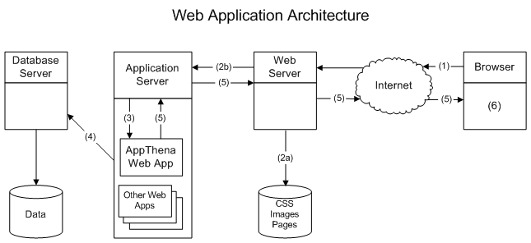
Web/App system architecture

Slide 17
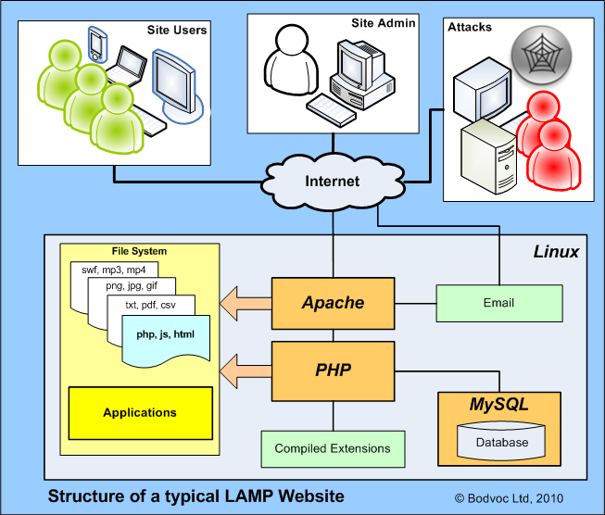
LAMP architecture

Slide 18
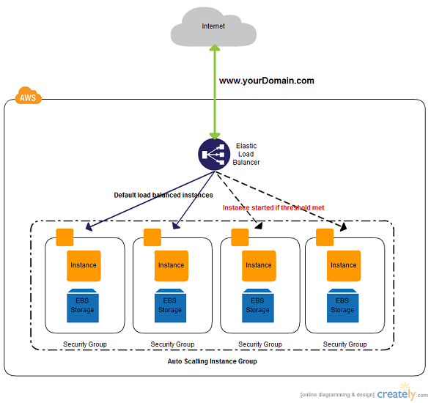
Real world app/web system architecture

Slide 19
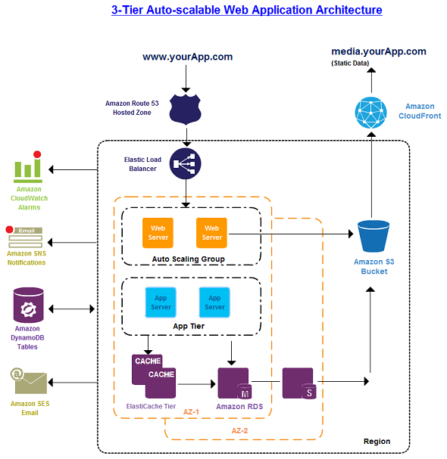
Real world app/web system architecture

Slide 20
[Build your first app]

Slide 21
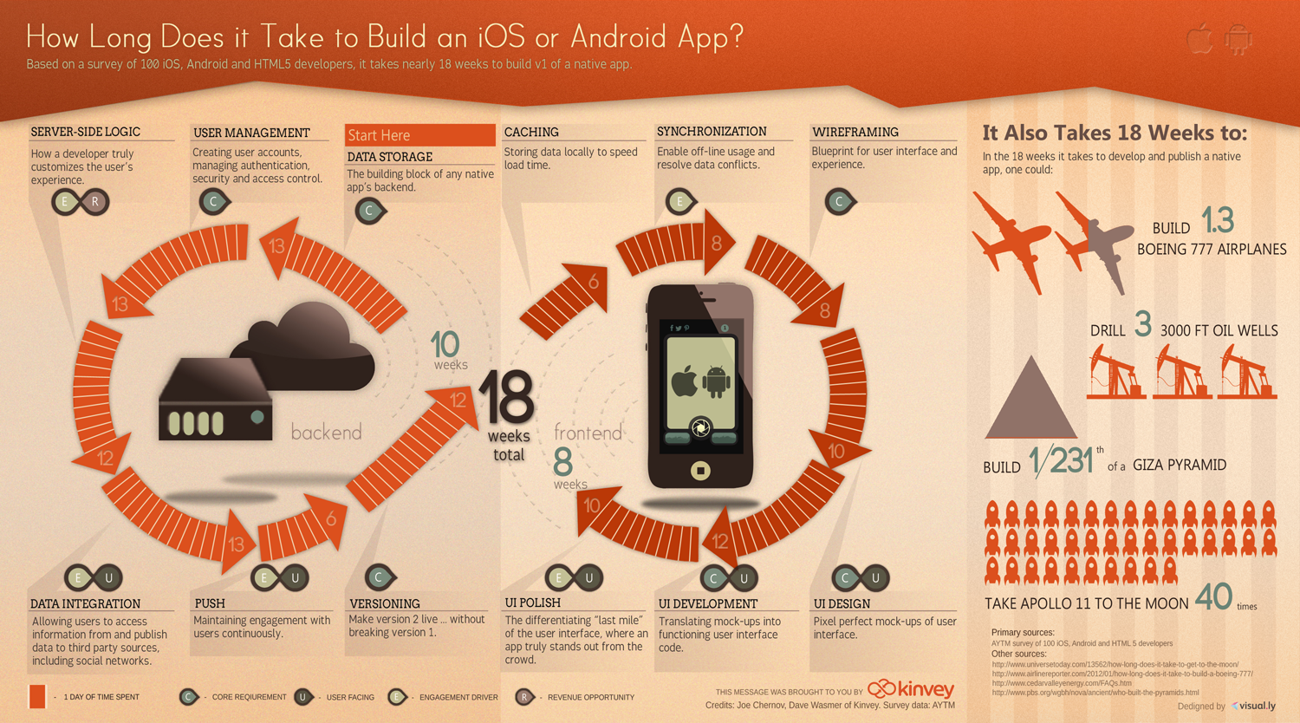
How long does it take to build an App?

Slide 22
12 Steps
Step 1 – define your goal
Step 3 – start sketching
Step 3 – research
Step 4 – create a storyboard and wireframe
Step 5 – define the back end of your mobile app
Step 6 – test your prototype
Step 7 – build the back end of your app
Step 8 – design the app skins
Step 9 – test again
Step 10 – revise and continue to build
Step 11 – refine each detail
Step 12 – release time

Slide 23
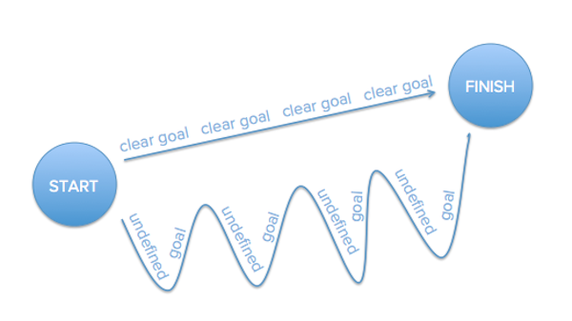
Step 1 – define your goal
Defining a clear goal for the app is also going to help you get there faster.

Slide 24
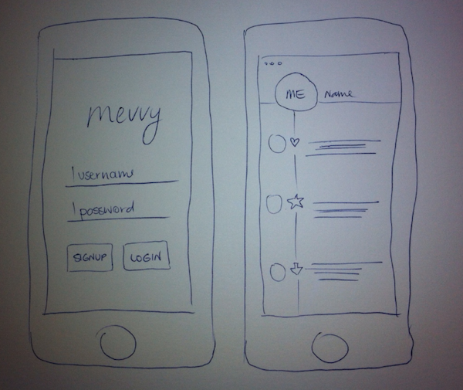
Step 2 – start sketching: idea forming

Slide 25
Step 3 – research
Find out whether there are other apps doing the same thing
Find design inspiration for your app
Find information on the technical requirements for your app
Find out how you can market and monetize your app

Slide 26
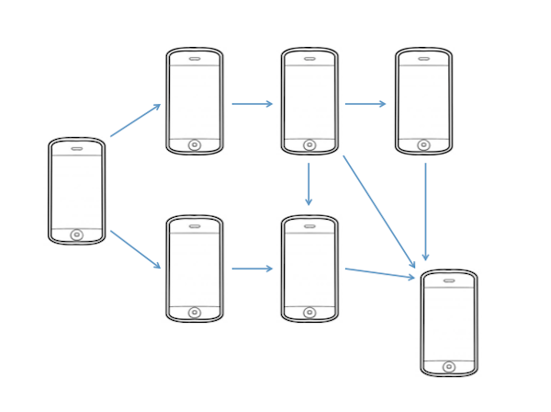
Step 4 – create a storyboard and wireframe
Wireframing is the process of creating a mockup or prototype of your app.
Storyboard
  The idea is to build a roadmap that will help you understand the connection between each screen and how the user can navigate through your app

Slide 27
Step 5 – define the back end of your mobile app
Draw a diagram of your servers, APIs, and data diagrams. This will be a helpful reference for the developer, and as more people join the project you will have a (mostly) self-explanatory diagram for them to study.

Slide 28
Step 6 – test your prototype
Revert to your wireframes and ask friends, family, colleagues, and experts to help you review your prototype.
The goal is to concretize your app concept before it goes into the design process! Once you start designing it is much harder to change things around, so the clearer the prototype from the start, the better.

Slide 29
Step 7 – build the back end of your app
Your developer will have to set up servers, databases, APIs, and storage solutions.

Slide 30
Step 8 – design the app skins
“Skins” are what designers/developers call the individual screens needed for the app. Your designer’s job is now to come up with high-resolution versions of what were previously your wireframes.

Slide 31
Step 9 – test again
Don’t confuse this stage with Step 6 (wireframing). At first it was about creating the basic look and feel of the app. Here you’ve implemented the actual design and made it clickable.

Slide 32
Step 10 – revise and continue to build
Once you’ve given your design a test drive and collected more feedback from future users, you should use these new ideas to polish your app idea.

Slide 33
Step 11 – refine each detail
Release to alpha users and testers
iOS
  Testflight
Android
  testFairy

Slide 34
Step 12 – release time
iOS
  iTunes store
Android
  Amazon
  Google play
Web ?

Slide 35


Slide 36
[Real world example – Parse.com]

Slide 37
Case study – parse.com
http://aws.amazon.com/solutions/case-studies/parse/
http://techcrunch.com/2013/04/25/facebook-parse/

Slide 38
Parse.com
Focus on creating a great user experience and stop worrying about server maintenance and complex infrastructure
Products
  Parse Core
    Connect your app to the cloud
    Save data with ease/ local and remote database
    Social and user management
    Share data across web, iOS and Android
    Run custom app code in the Parse Cloud
  Parse Push
    Send out push notifications via the Push Console
    Or push from anywhere
  Parse Analytics
    Measure app usage
    Optimize push campaigns

Slide 39
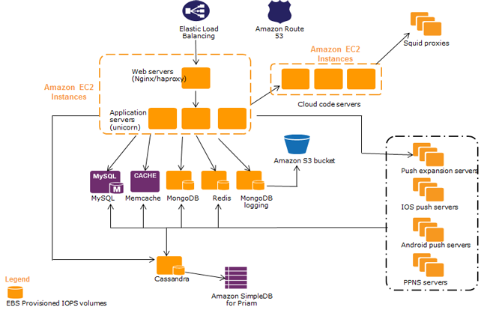
Parse.com system architecture

Slide 40
Homework
Proposal for system architecture - diagram
Prepare for design review/design tomorrow

Slide 41
Reading list
http://en.wikipedia.org/wiki/Front_and_back_ends
https://www.facebook.com/note.php?note_id=461505383919
http://en.wikipedia.org/wiki/NoSQL
http://www.forbes.com/sites/oreillymedia/2014/04/11/full-stack-developer-is-a-tall-order-bordering-on-unicorn-territory/
http://en.wikipedia.org/wiki/Mobile_app
http://en.wikipedia.org/wiki/Mobile_application_development
http://www.kinvey.com/blog/2086/how-long-does-it-take-to-build-a-mobile-app
http://experts.allbusiness.com/12-step-guide-to-building-your-first-mobile-app/11193/#.VC9tNCtdXjF

Slide 42
~ END ~
http://www.alphacamp.tw

